Slide 1
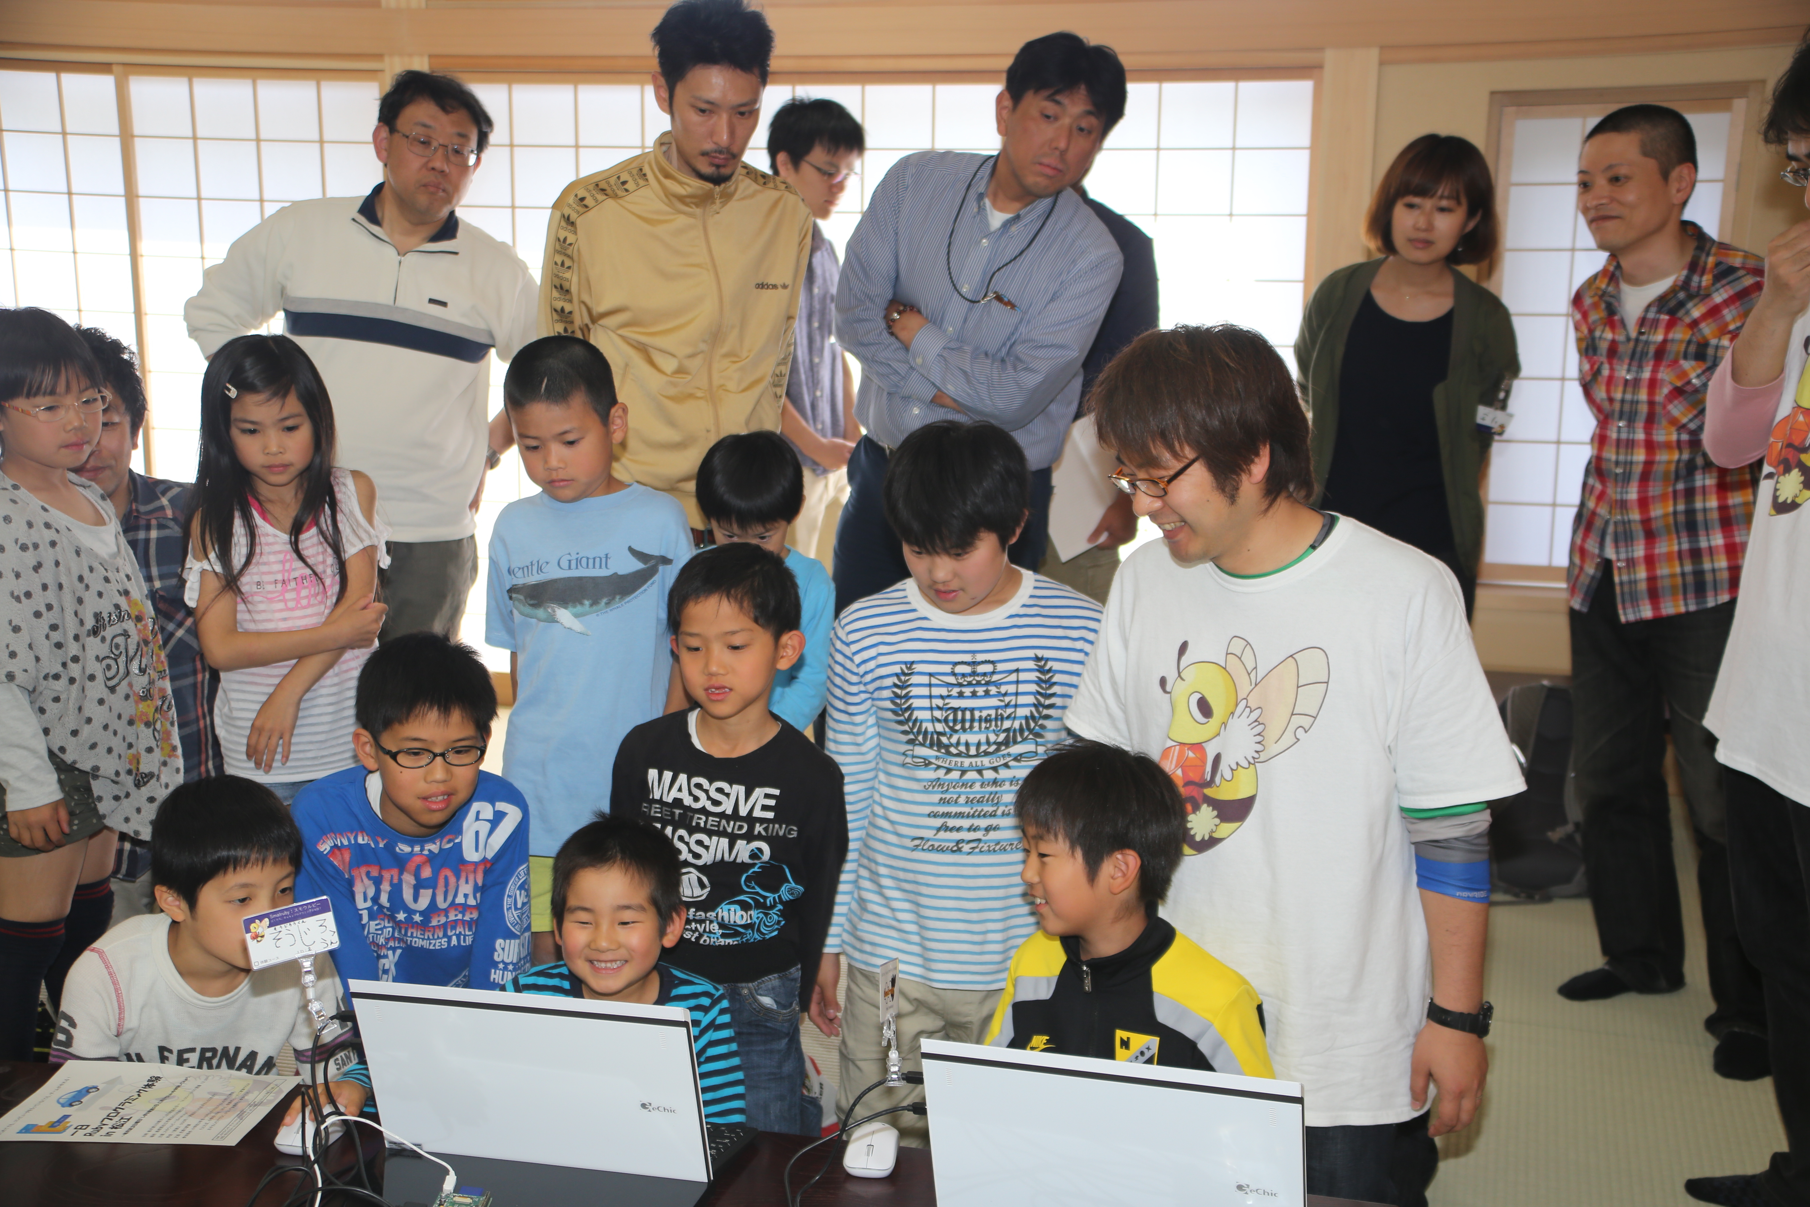

Kids, Ruby, Fun!
Introduction of the Smalruby and Ruby Programming Shounendan
Kouji Takao,
The Ruby Programming Shounendan,
RubyConf 2014, 11.19.2014
Notes:
Thank you for attending. This presentation is called “Kids, Ruby, Fun”. I will discuss our activities with the Ruby Programming Shounendan, especially Smalruby which is a key part of it.
Let's begin.

Slide 2
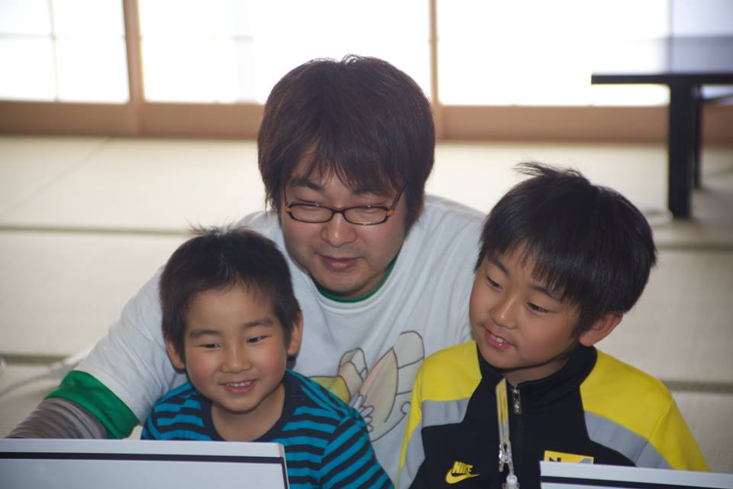
Kouji Takao
CRuby commiter (Readline module)
A leader of the Ruby Programming Shounendan Shounen = Boys & Girls Dan = Organization
Engineer of NaCl
Contact kouji@smalruby.jp @takaokouji Facebook
Notes:
I am Kouji Takao, one of the CRuby commiters, and a leader of the Ruby Programming Shounendan. Shounendan is a Japanese word. “Shounen” means boys and girls, “Dan” means an organization, so “Ruby Programming Shounendan” means a boys and girls organization for leaning Ruby programming.
Also, I am a research engineer at Network Applied Communication Laboratory, aka NaCl.

Slide 3
Made possible by
NaCl
Notes:
This presentation is made possible by NaCl.
NaCl, of course, is famous for being Matz’s employer, but that’s not all we do.

Slide 4

NaCl is in
Matsue, Shimane, Japan
http://en.wikipedia.org/wiki/File:Japan_location_map_with_side_map_of_the_Ryukyu_Islands.svg : Maximilian Dörrbecker (Chumwa) CC-BY-SA 3.0CC by SA
Notes:
The headquarters of NaCl, is located in Matsue-city, Shimane Prefecture of Japan.
Matsue is a city of about 200,000 people near Hiroshima.

Slide 5

NaCl is
SIer
Notes:
NaCl’s core business is system integration.
There are about 60 employees.

Slide 6
NaCl has
30
Rubyists
Notes:
About half of the employees are using Ruby to develop software.

Slide 7
NaCl has
6
Commiters
Notes:
Including Matz, there are six CRuby committers at NaCl.

Slide 8
Please
visit
NaCl♪
Notes:
Please visit NaCl in our idyllic provincial city, Matsue, if you are interested.
Okay, So I’ll return to the main topic.

Slide 9
6 years ago,
Notes:
6 years ago,

Slide 10
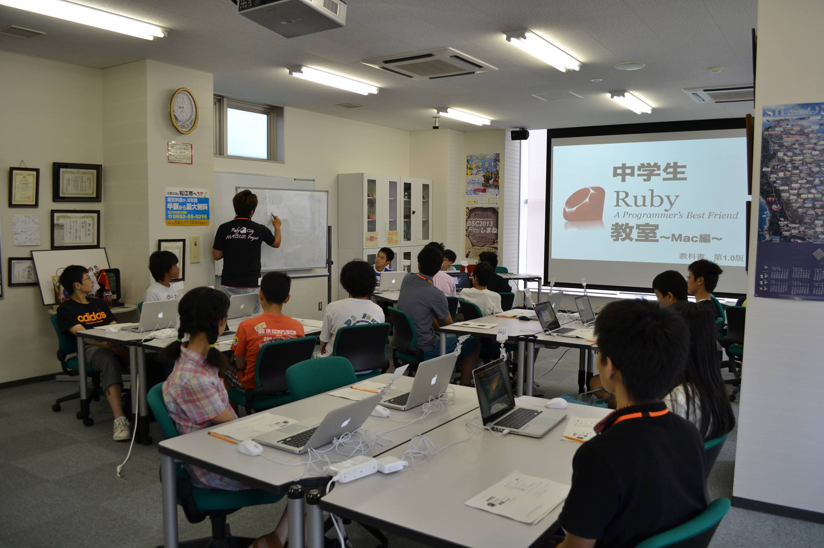
Started to Teach Ruby for youth
Notes:
I started to teach Ruby programming for junior high school students. In Japan, junior high school student is ages of 13 to 15, so junior high school student in this presentation.

Slide 11
Motivations
Ruby City MATSUE Project
Teach my son Ruby
Notes:
My motivations were the Ruby City MATSUE project and to teach my son Ruby.

Slide 12
Ruby City MATSUE Project
By Matsue-city
For Raising IT Business
Increase Rubyists
Find Ruby teachers
Notes:
The Ruby City MATSUE Project was managed by the city government. Matz, who created Ruby, lives in Matsue. Ruby generated new business, so the government decided to promote IT business using Matz and Ruby in Matsue!
Then the government started this project to help IT businesses. Also, IT businesses require many IT engineers. So one purpose of the project was to increase the number of Rubyists.
6 years ago, the project was looking for teachers that could teach Ruby to the youth.

Slide 13
Teach my son Ruby
I love Ruby
Make something for teaching Ruby to youth
Notes:
My second goal was my real motivation.
I love Ruby and IT engineering, so I plan to teach Ruby to my son to become an IT engineer when he grows up.
However, 6 years ago, I did not have any tools or materials for teaching Ruby to youth, also KidsRuby did not exist at that time.
So, I decided to make tools and materials for teaching Ruby to youth.

Slide 14
Find Ruby teachers
Make something for teaching Ruby to youth
Teach Ruby to youth
Notes:
So, I started teaching Ruby to youth 6 years ago.

Slide 15
Now
1% / year
in Matsue-city
Notes:
Since then, I have taught Ruby to over 250 junior high school students. This number is low.
However, only 5,500 junior high school students live in Matsue-city, so I teach about 1% junior high school students in Matsue-city each year.

Slide 16

Ruby is
and Kids
A Programmer’s
Best Friend
Notes:
How is Ruby for programming education?
As you know, Ruby is "A Programmer's best friend".
Ruby:
* has Simple syntax,
* is Object-oriented and
* has a Garbage collector.
<press>
So I believe it’s the same for kids who want to start to code.

Slide 17
Problems
Typing
English
Ruby syntax
Notes:
In these 6 years teaching ruby in Japan, I’ve encountered these problems:
<press>
First, typing is difficult. Most kids don’t know how to make use of Symbols, pressing “shift + ,” is hard!
<press>
Second, English… English is hard… ☹ They can understand the roman alphabet, but basic words like “if”, “end”, “do” are still challenging.
<press>
Third, kids don’t know Ruby syntax and standard libraries. So, they are not able to work on their own, which leads them to slow down the learning experience pace and be frustrated. It also increases the need for more instructors in the classroom.
Therefore, kids often quit before they realize that programming is fun.

Slide 18
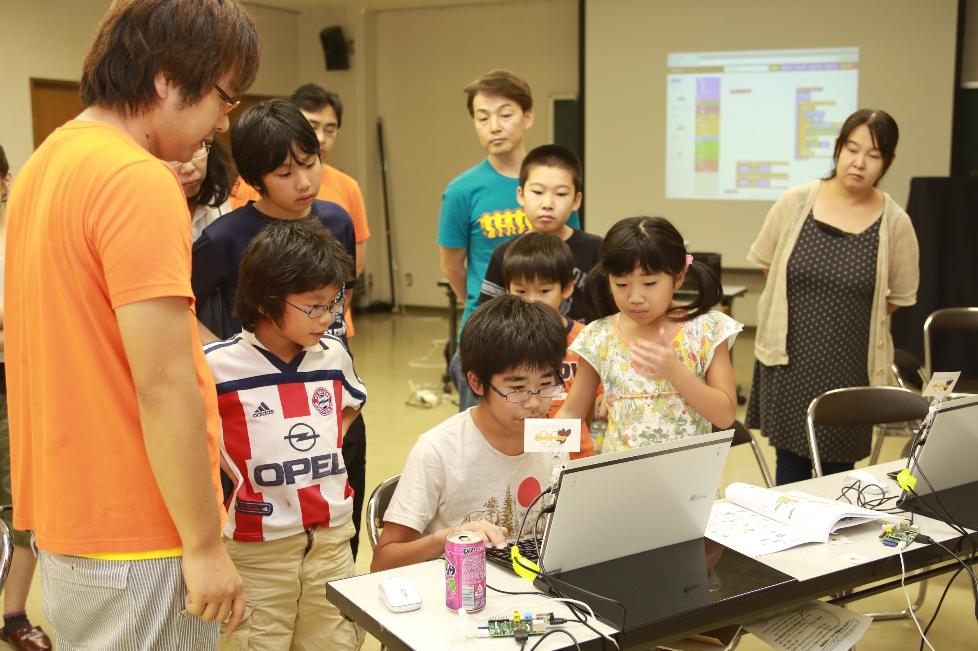
Recently,
Raised Programming Education
Notes:
By the way, programming education for elementary and middle school students, have been raised world wide the last few years.

Slide 19

U.S.
20,000 Teachers
Notes:
Programming education is being done most actively in America.
In a New York Times article from May 10, 2014, twenty thousand teachers from kindergarten to high school incorporated programming classes into their curriculum.
In addition, President Obama has been saying that programming is necessary and should be a compulsory subject. So hopefully this flow will accelerate.

Slide 20

U.K.
Compulsory education
Notes:
Next, in September the United Kingdom officially introduced programming to the new compulsory education curriculum for ages five to 16. At the age of five, understanding of the concept of algorithms, building and debugging a simple program has been incorporated, so it is practical.

Slide 21



etc…
Notes:
In addition, there are movements to introduce programming education in many other countries. For instance, Estonia, Finland, Singapore and others.

Slide 22
Japan
Notes:
Then, we will introduce the situation in Japan.

Slide 23
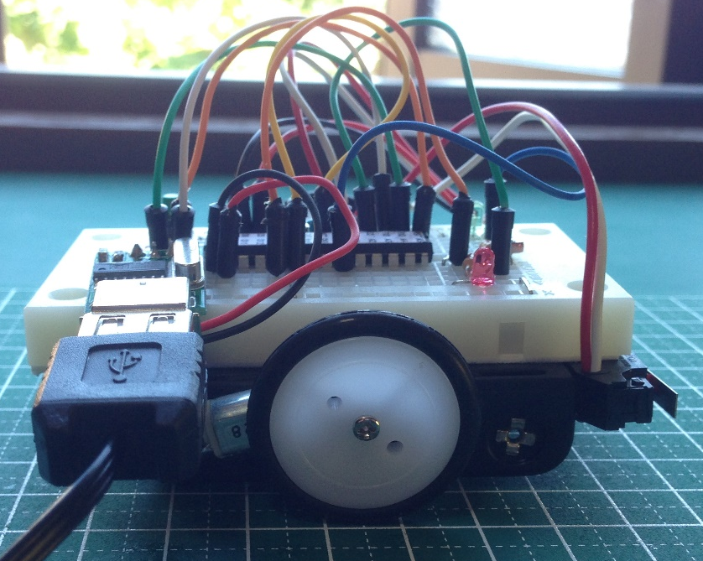

Compulsory education
Jounior high school / Since 2012
Sensor
Motor
Notes:
First, programming class in junior high school is already required from April 2012.
Its name is "measurement and control“. In that class, projects that include controlling a small robot car are very popular. For example, making this robot follow remote directions or to move while making us of different kinds of sensors are pretty common.

Slide 24
1 Computer / 1 Student
～2020
Distributed tablets to
all 6-12 ages in Saga-city
Notes:
Also, in 2011, the Japanese government declared that by the year 2020 every student would have access to an exclusive computer.
For instance, in this year’s April, the project has distributed tablets to all elementary school students from Saga-city. The programming classroom schedule has started in October 20th.

Slide 25
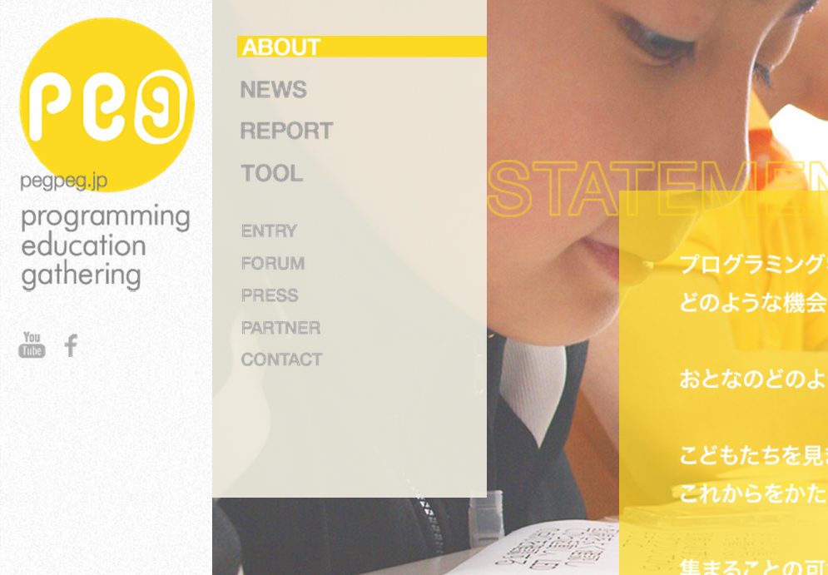
PEG
Joint project of CANVAS and Google
CANVAS hold many workshops for children
Distributed 5,000 Raspberry Pi
http://pegpeg.jp/
Notes:
Information technology and the introduction of programming education is progressing in compulsory education in this way, but at the same time, the activities of private companies have also been actively carried out.
Especially recently, the PEG which is a for spreading programming education project, become a hot topic. PEG is a joint project of CANVAS and Google. CANVAS is an NPO of Japan has held workshops for children, it is not only programming. PEG has held programming workshops, and has distributed Raspberry Pi of 5,000 units for education business owners in Japan.

Slide 26
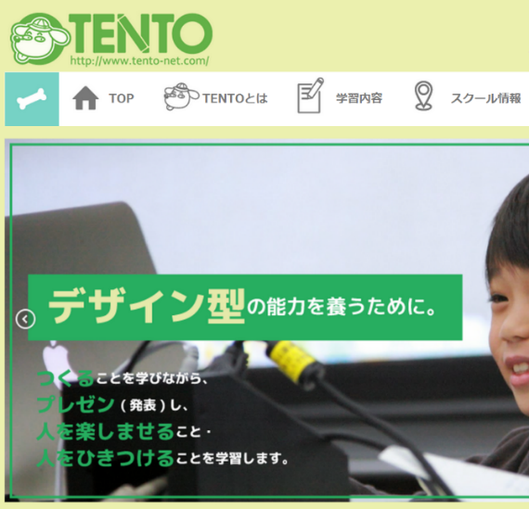

TENTO
Life is Tech!
http://www.tento-net.com/
http://life-is-tech.com/
Programming education as a Service
= PaaS ;-)
Notes:
In addition, “TENTO” manages individualized teaching programming school. “Life is Tech!” manages about five days camping and weekly school for programming.
“TENTO” and “Life is Tech!” receive a participation fee or tuition, I just interesting is that they manages programming school as business.
Other than those discussed here, workshop of a variety of programming education has been held, programming education for youth has come raised in Japan as well as overseas.

Slide 27
Why many kids programming workshops are held?
Great tools and materials!
Notes:
By the way, do you think that why many kids programming workshops are held recently?
I believe that we have great tools and materials for teaching programming to youth.

Slide 28
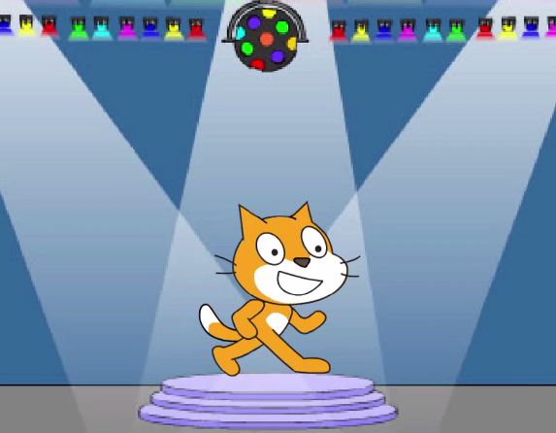

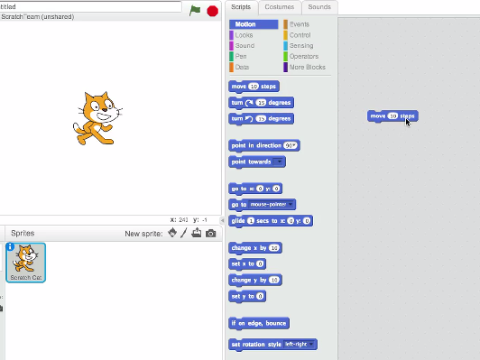

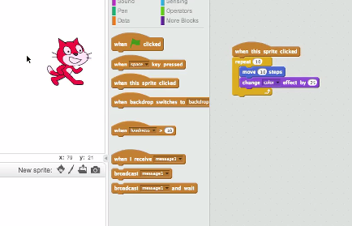

by MIT Media Lab
http://scratch.mit.edu/
http://vimeo.com/65583694
Notes:
Yes, it’s “Scratch”. “Scratch” is most famous programming education tool.
Scratch is a visual programming language and tool. MIT has developed it. It is used in the following classes and workshops of many programming. Scratch’s users are more than 2 million worldwide. In Japan, it has been most often used in the workshop of programming education in elementary and junior high school students.
多くのプログラミングの授業やワークショップではMITが開発している Scratch というビジュアルプログラミング言語が使われています。Scratch のユーザは全世界で200万人以上で、日本の小中学生向けのプログラミング教育のワークショップでは最も多く利用されています。

Slide 29
Blocks
= Instructions
Combination
of blocks
= Program
Notes:
In Scratch, instructions are blocks, and combination of blocks describe your program, so you are easy to find instruction and make program.

Slide 30
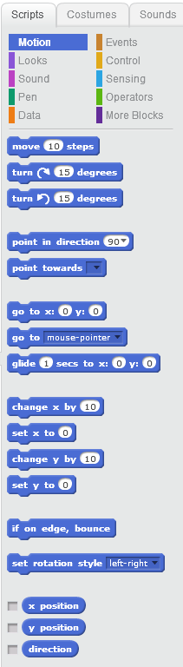
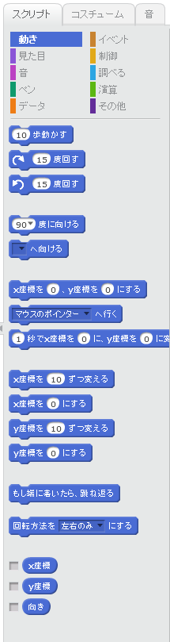
Internationalization
English
Japanese
Notes:
Also Scratch supports internationalization, so Japanese kids are easy to understand everything.

Slide 31
Easy to run
Notes:
If you want to run your program, you only push the green flag on screen then your program starts to run.

Slide 32
Problems
Typing
English
Ruby syntax
Blocks
Internationalization
Combination of blocks
Notes:
So I believed that Scratch’s features will solve my problems.

Slide 33

Ruby + Scratch
Hi,
I’m Hatti!
Smalruby
Notes:
So, we have developed Smalruby.

Slide 34
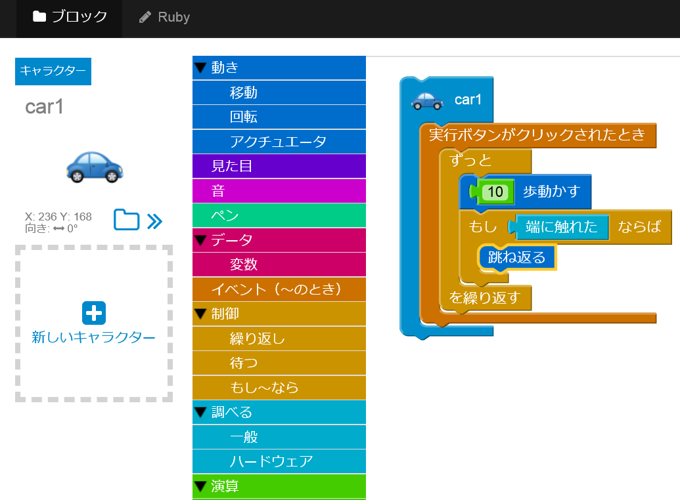
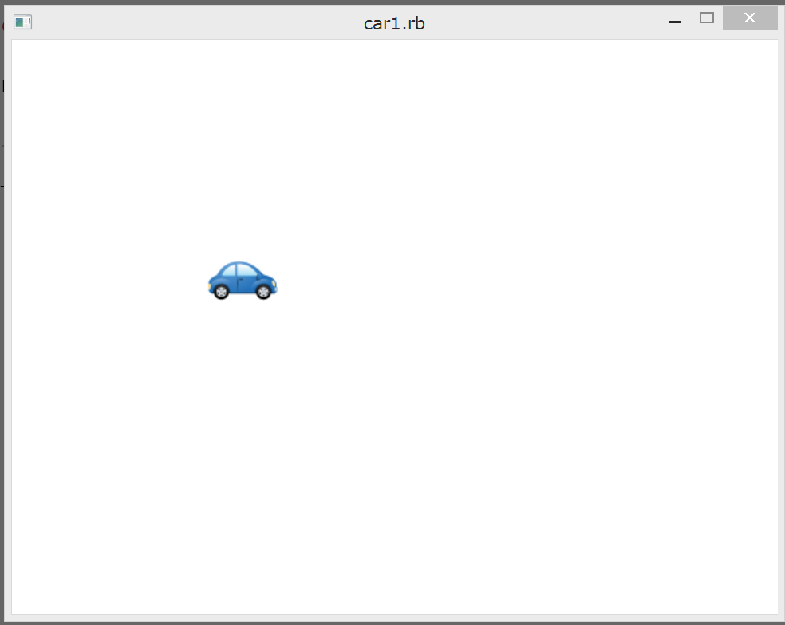
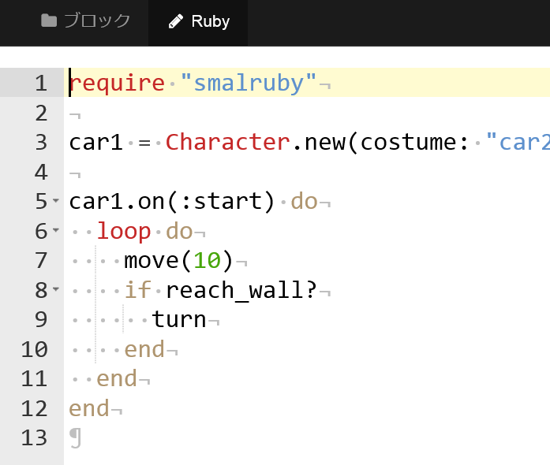
Demo
Notes:
Immediately, I will show what is Smalruby.
(Highlight a character, then press the Enter button, “Ruby” button to place the instruction block, run the ruby in the background, the character will move.)
This is Smalruby.

Slide 35
Matsue city
Ruby classes in whole municipal junior high school
By 09.04.2014/local news paper(Sanin Chuo Shinpou)
Notes:
And, in Matsue, Shimane Prefecture, that teach the Ruby all of Matsue municipal junior high school, students of about 5,500 from April 2016.
You learn Ruby in compulsory education only Matsue even looking for all over the world.
It’s good!
ちなみに、島根県松江市では2016年度から松江市立の全中学校、約5,500人の生徒にRubyを教えることが決定しています。
義務教育でRubyを学べるのは世界中を探しても松江市だけです。
ほら、松江市に遊びに来たくなったでしょ♪

Slide 36
The Ruby
Programming Shounendan
Notes:
First of all, I am going to introduce the Ruby Programming Shounendan.
まずは、Rubyルビープログラミング少年団についてですね。

Slide 37
“Promoting the joy of programming to many kids. “
“Building internet safety awareness for kids through programming!”
Notes:
It is an NPO for kids, that has been working under the banner of “Promoting the joy of programming to many kids. “ and “Building internet safety awareness for kids through programming!“.
この団体は 「一人でも多くの青少年にプログラミングの喜びを！」「プログラミングを通じて青少年とネット社会との関わり方を考える組織を地域社会の中に！」 を掲げて活動している青少年のための任意団体です。

Slide 38
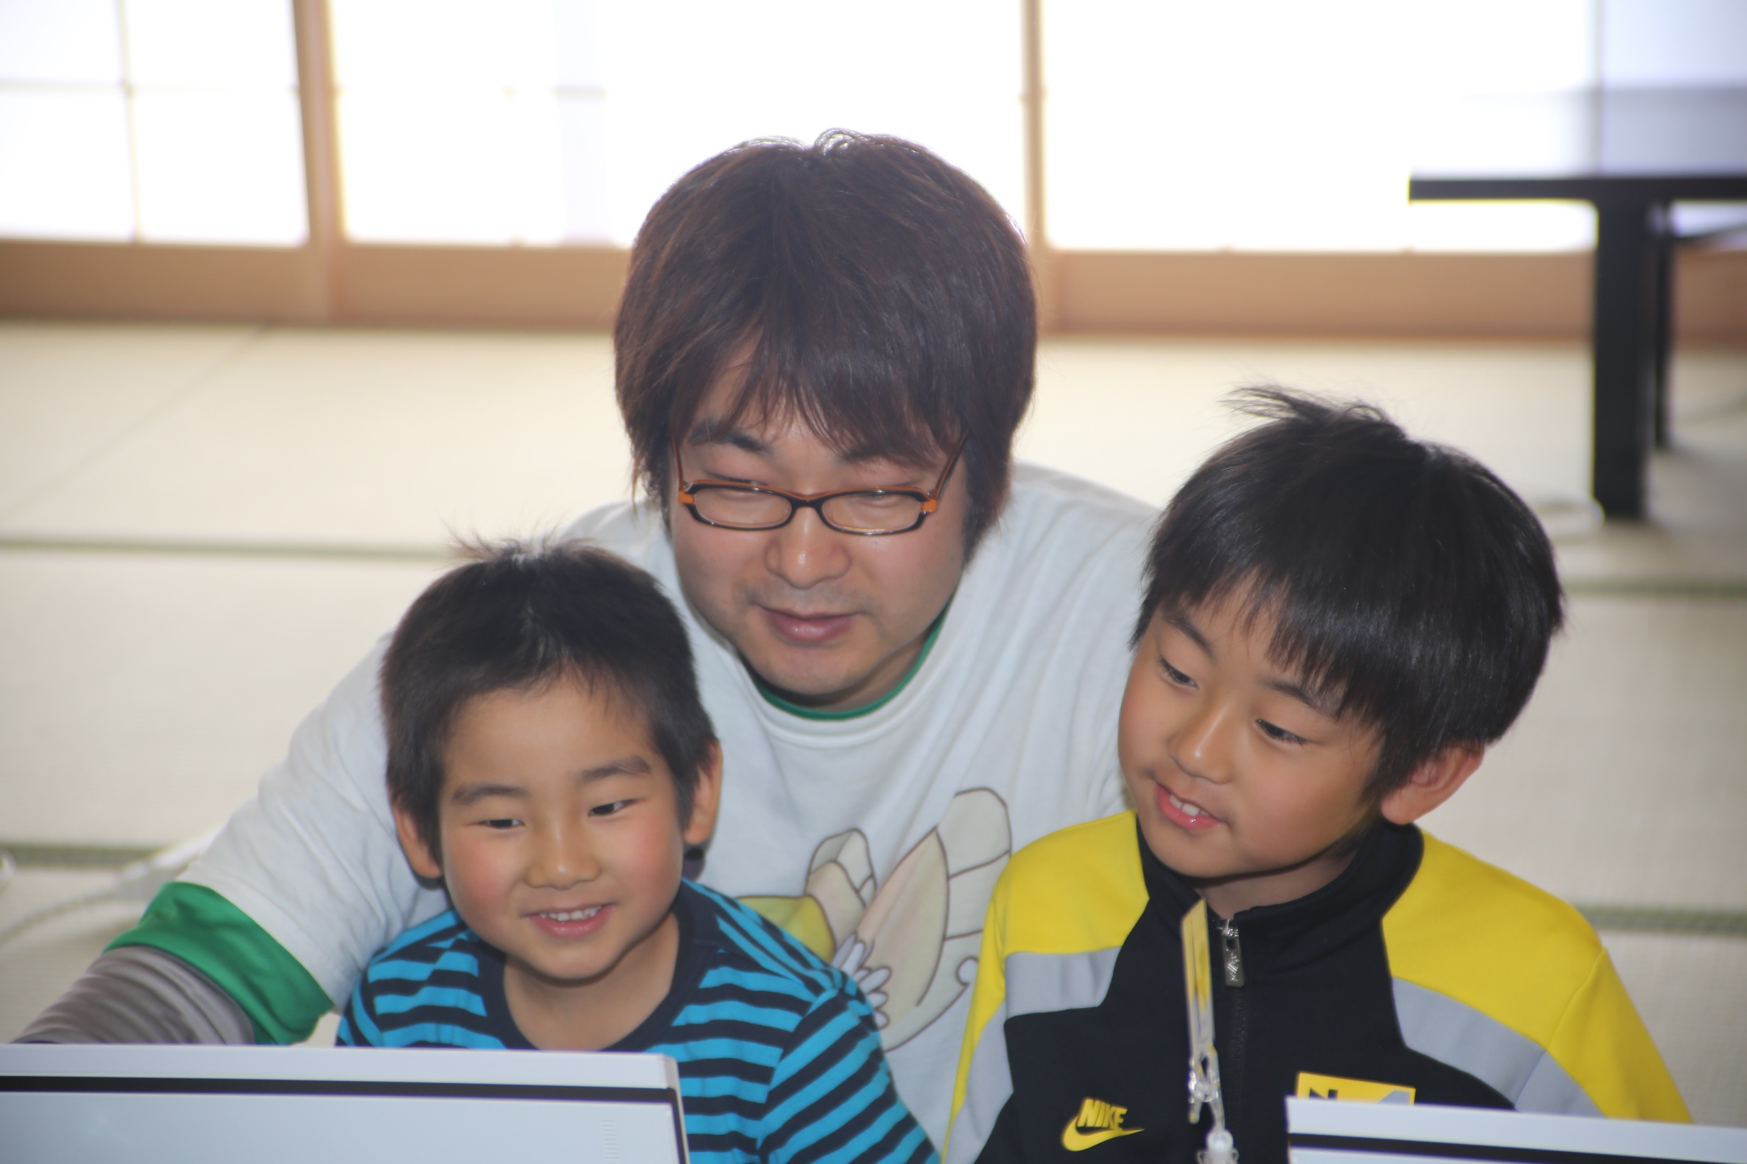
Ruby programming events for kids
and parents
Introducing Ruby,
once a month
Notes:
We have numerous activities. On the third Sunday of each month, we hold a ruby programming event for kids and parents.
現在の主な活動は、毎月第3日曜日に親子向けのプログラミング体験教室を開催しています。

Slide 39
CoderDojo Matsue
https://coderdojo.com
Free Ruby computer programming club for Kids,
once a month
Notes:
Also, we hold the CoderDojo Matsue on the fourth Saturday of each month.
The CoderDojo is the global network of free computer programming clubs for young people. It is managed by volunteers. The CoderDojo doesn’t specify which programming language or tools to use, so we are using Ruby.
また、毎月第4土曜日にコーダー道場松江を開催しています。

Slide 40
The Ruby Programming Shounendan
Team
Contest
≒
Coach
The Boy & Girl Scouts for
Ruby programming
Notes:
In the future, we will be like a youth sports club for soccer or baseball:
* There will be many teams
* Volunteer coaches
* With regional, prefectural (which is like a state) and national tournaments
We plan to make such an organization.
将来は、野球やサッカーのスポーツ少年団(少年団の対訳:boy scout)のように、
* 各地域にそれぞれの特色を持ったチームがあり、
* ボランティアのコーチがいて、
* 地区大会、県大会、全国大会みたいな試合があるような、
そんなプログラミング少年団を作りたいと考えています。

Slide 41
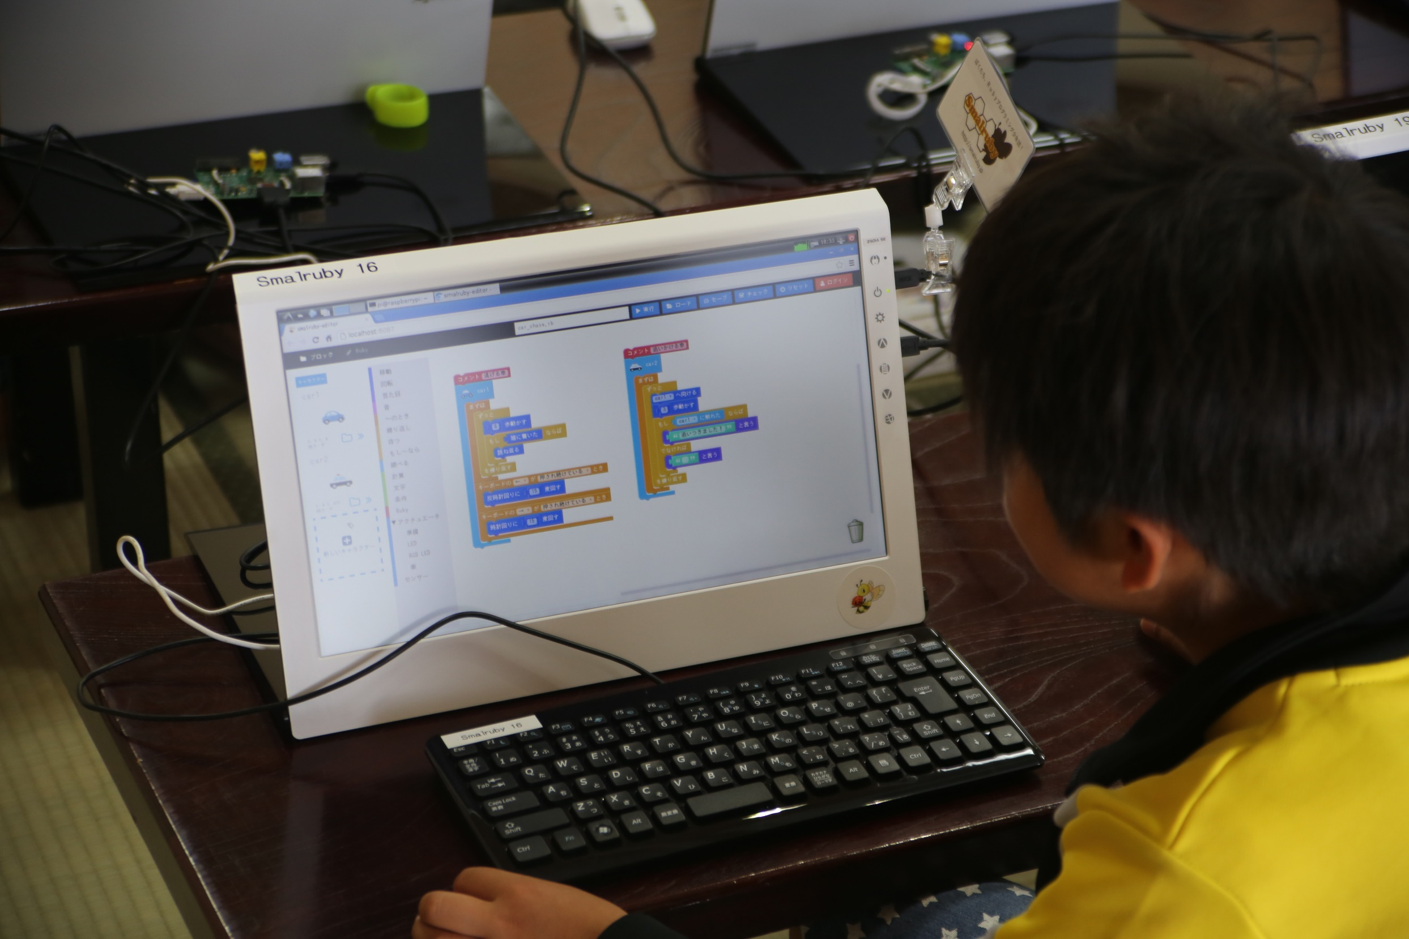
Kids want to be challenged!
Notes:
It is now possible to programming of Ruby using the instruction block in this.
Then, when I got used to the children actually, it was found that interesting.
Some of kids want to do a full-fledged programming, for example, they want to find a prime number.
They will not be satisfied with programming using the instruction block at an early timing. And, they will want to enter the code directly.
これで命令ブロックを使ってRubyのプログラミングができるようになりました。
そして、実際に子供たちに使ってもらったところ、面白いことがわかりました。
素数を求めたいとか、やりたいことが決まっているなど、本格的にプログラミングをやりたい子どもは、早いタイミングで命令ブロックによるプログラミングでは満足できなくなり、コードを直接入力したいというのです。

Slide 42
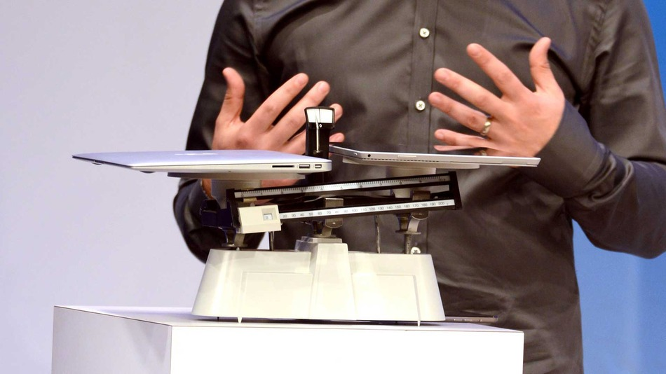
We think…
Programming
＞
Creativity and
Logical thinking
http://mashable.com/2014/05/20/surface-pro-3-macbook-air-compared/
Notes:
<WIP>
I believe still in Smalruby, so that we can stick to that it can be converted to each other instruction block with the source code of Ruby.
The trend of programming education are raised now, programming is a tool only, it is intended that the foster logical thinking and creativity are many, but we put more emphasis on teaching the programming itself we would like.
それでもスモウルビーでは、Rubyのソースコードと命令ブロックを相互に変換できることにこだわっていきたいと考えています。
現在盛り上がっているプログラミング教育の傾向としては、プログラミングはあくまで道具であり、創造性や論理的思考力をはぐくむことを目的としていることが多いのですが、私たちはプログラミングそのものを教えることにより重点を置きたいと考えています。

Slide 43



Vim Icon : http://www.vim.org/index.php
Emacs icon : http://ochiailab.blogspot.jp/2013/04/powerlineelemacs.html
Sublime Text icon : http://blog.livedoor.jp/nonprofessional/archives/1004031653.html
Notes:
<WIP>
Once you have learned the basics of the program at the instruction block, I want to now be able to create the program by typing the source code of Ruby directly at the earliest possible timing. And, I believe you will find your favorite editor of his own, programming like we want you to become a favorite programmer.
命令ブロックでプログラムの基礎を学んだあとは、なるべく早いタイミングで直接Rubyのソースコードを入力してプログラムを作成できるようになってほしい。そして、自分の好きなエディタを見つけて、私たちのようなプログラミングが好きなプログラマになってほしいと考えています。

Slide 44

Welcome
Developers,
Workshop
Owners
Notes:
Smalruby is developing by myself.
If you are interested, please implement some features then make a Pull Request.
Also, anybody that would like to hold a workshop for kids using Smalruby is welcome.
If you need information about how to carry out programming workshops, or if you need teaching materials including textbooks, please feel free to contact me.
スモウルビーは私一人で開発しています。
興味がある方は、ぜひPull Requestをお願いします！
また、スモウルビーを使って子供向けのワークショップを開催してみたいという人もウェルカムです。
ワークショップの進め方、教科書を含む教材などの情報提供をしますので、気軽に声をかけてください。

Slide 45
Visual editor
・Rails
・Blockly
Runtime
Windows : DXRuby
Mac,Linux : dxruby_sdl, Ruby/SDL
Notes:
The visual programming editor of Smalruby, we have implemented as a Rails application.
The functions, you can create a program with a combination of instruction block, to generate the source code of Ruby from there, We have implemented using the Blockly which is a JavaScript library.
The program that you created using Smalruby are run with the DXRuby on Windows. DXRuby is a rubygem, it provides 2D graphics, playback music and event handling. If you use Mac or Linux, you can use dxruby_sdl and Ruby/SDL rubygem. Theses provide DXRuby compatible API on Mac and Linux.
スモウルビーのエディタ機能は、Railsアプリケーションとして実装しています。
命令ブロックの組み合わせでプログラムを作ったり、そこからRubyのソースコードを生成する機能は、Blocklyというライブラリを使って実現しています。
スモウルビーで作成したプログラムは、WindowsではDXRuby、Mac OS XとLinuxではDXRuby互換APIを提供するdxruby_sdlとRuby/SDLを利用して、2Dグラフィックス、音楽の再生、イベントハンドリングを実現しています。

Slide 46

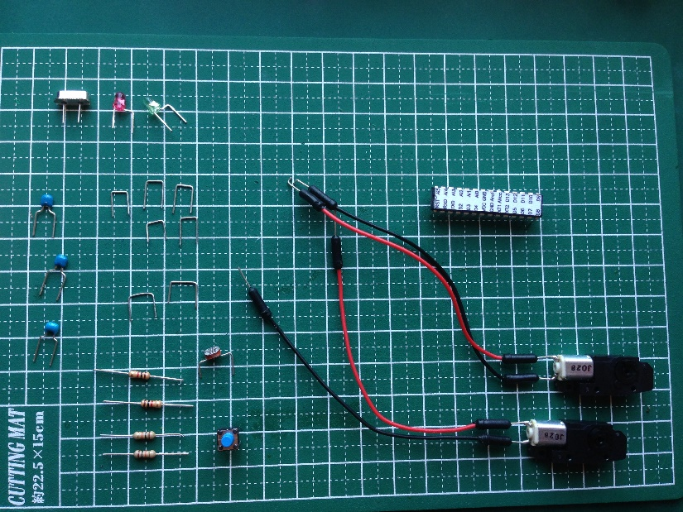
Smalrubot
・Aruduino
・Dino
GitHub: austinbv / dino
Notes:
<WIP>

Slide 47
Instruction Block
Ruby
Notes:
Many of those who first saw Smalruby, it is surprising that it is possible to make a program by combination of instruction block.
Ruby has been so easy! ?
スモウルビーを初めて見た方の多くは、命令ブロックの組み合わせでプログラムを作ることができることに驚かれます。
Rubyってこんなに簡単なんですか！？とかね。

Slide 48
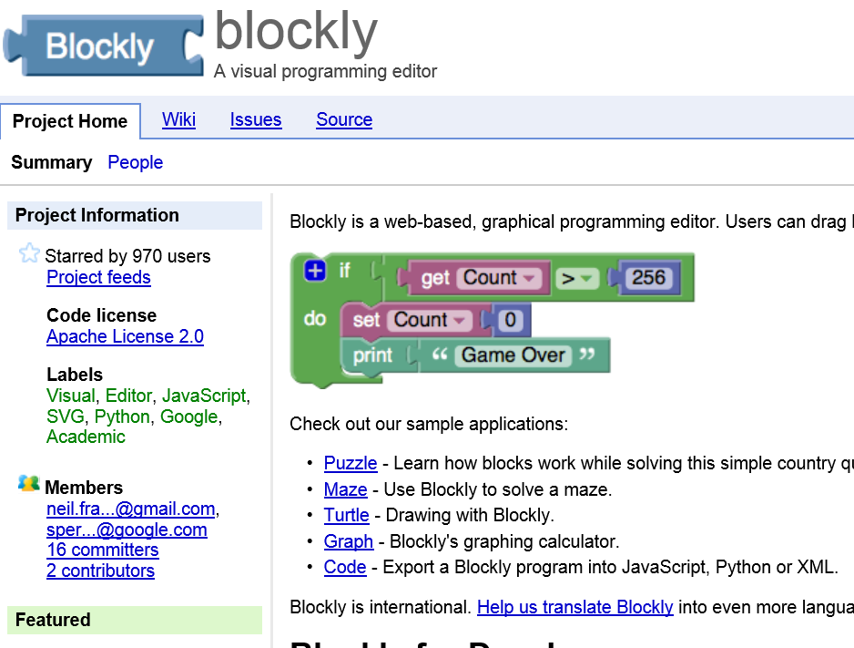
http://code.google.com/p/blockly/
Notes:
Actually processing related to the Smalruby’s instruction blocks, we have implemented using Blockly that is a JavaScript library, and that is made by Google​​.
Blockly has been developed using the Google Closure library, dependency is small, code size is small, the installation is simple, it has become a thing very easy to use and to develop a visual programming editor that runs in a web browser.
実はスモウルビーの命令ブロックに関する処理は、Google製のBlocklyというJavaScriptのライブラリを使って実現しています。
BlocklyはGoogle Closure libraryを使って開発されており、依存関係も少なく、コードサイズも小さく、インストールも簡単で、ウェブブラウザで動作する visual programming editor を開発するにはとても使いやすいものになっています。

Slide 49
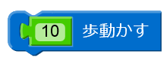
Define Instruction Block
Blockly.Blocks['motion_move'] = {
init: function() {
this.setColour(208);
this.interpolateMsg('%1歩動かす',
['STEP', ['Number'], Blockly.ALIGN_RIGHT],
Blockly.ALIGN_RIGHT);
this.setInputsInline(true);
this.setPreviousStatement(true);
this.setNextStatement(true);
}
};
(歩動かす = move)
/app/assets/javascripts/blocks/motion.js.coffee.erb
Notes:
Let's look at how to actually do to define the instruction block using Blockly.
This is the definition of the instruction block called "move 10 steps" the character that we showed you in the previous demo.
First, you name ‘motion_move’ to the instruction block then assign an object to it.
Next, you implement the initialization process of the instruction block to init property of the object.
Here,
* (SetColour) Blue
* (interpolateMsg) The label is “move blah-blah-blah steps”, and the ability to set the instruction block that represents a number which name is STEP
* (setInputsInline) Display on one horizontal row
* (setPreviousStatement) Connectable an other instruction block before this
* (setNextStatement) Connectable an other instruction block after this
We have specified the above.
With just of this, you can define the instruction block.
それでは、実際にどのようにして命令ブロックを定義するのか見てみましょう。
これは先ほどのデモでお見せしたキャラクターを「10歩動かす」という命令ブロックの定義です。
まずは命令ブロックに'motion_move'という名前をつけて、それを表現するオブジェクトを代入します。
そのオブジェクトのinitプロパティに命令ブロックの初期化処理を記述します。
ここでは、
* (setColour)青色
* (interpolateMsg)STEPという名前で数値を表現した命令ブロックを設定できること、そのラベルが「～歩動かす」であること
* (setInputsInline)それらを横一列に表示すること
* (setPreviousStatement)この命令ブロックの前に、命令ブロックをくっつけられること
* (setNextStatement)この命令ブロックのあとに、命令ブロックをくっつけられること
を指定しています。
これだけで、命令ブロックを定義できます。

Slide 50
Generate Ruby from Block
Blockly.Ruby['motion_move'] =
function(block) {
var arg =
Blockly.Ruby.valueToCode(this,
'STEP',
Blockly.Ruby.ORDER_NONE);
return 'move(' + arg + ')';
};
/app/assets/javascripts/blocks/motion.js.coffee.erb
Notes:
In order to generate the Ruby code from the instruction block, you can define a method that returns a string which is representing the code of Ruby, and that takes an instance of the instruction block which you defined.
Here,
* get the value of the instruction block that you specified in STEP,
* make the string “move(its value)”, and return it.
The good news, to put parentheses around by operator precedence and adjustment of indentation, framework of Blockly will do.
In Smalruby, The definition of the instruction block, and has realized the code generation of Ruby from the instruction block, are implemented using the framework of Blockly.
命令ブロックからRubyのコードを生成するには、先ほど定義した命令ブロックのインスタンスを引数にとり、Rubyのコードを表現した文字列を返すメソッドを定義します。
ここでは、
* STEPに指定した命令ブロックの値を取り出して、
* move( その値 ) という文字列を作って、それを返しています。
インデントの調整や演算子の優先順位によって括弧でくくったりするのは、Blocklyのフレームワークがやってくれます。
このようにスモウルビーでは、Blocklyのフレームワークを使って、命令ブロックの定義、命令ブロックからRubyのコード生成を実現しています。

Slide 51
Ruby
Instruction Block
(歩動かす = move)
Notes:
From this experience, I was able to be converted to the instruction block from Ruby code in Smalruby. This is a distinctive feature of Smalruby that have not been implemented much in other Visual Programming Editor. <- 重要なのでわかったほうがいい。
However, the framework of Blockly for converting the instruction block from the source code does not provide, so we need to implement it by myself.
このような経験から、スモウルビーではRubyのコードから命令ブロックに変換できるようにしました。これは他のVisual Programming Editorにはあまり実装されていないスモウルビーの特徴的な機能です。
しかしながら、Blocklyはソースコードから命令ブロックに変換するためのフレームワークは提供していませんので、独自に実装する必要がありました。

Slide 52


Ruby
“Blockly’s XML”
(歩動かす = move)
Notes:
Finally it is the turn of Ruby.
In Smalruby:
* Send the source code of Ruby to Rails application
* Analyze it
* Convert to XML of expressing the instruction blocks
* Return the XML to the browser
* Read the XML then display as instruction blocks
We have implemented the conversion from source code of Ruby to the instruction block in this way.
それ、Rubyでできるよ！ってことで、スモウルビーでは、
* RubyのソースコードをいったんRailsに送って
* それを解析して
* 命令ブロックを表現したXMLに変換して
* ブラウザに返す。
* それを読み込んで命令ブロックとして表示する、
というようにして、Rubyのソースコードから命令ブロックへの変換を実現しています。

Slide 53
Translate Block from Ruby
class MotionMove < CharacterMethodCall
blocknize '^\s*' + CHAR_RE + 'move\((.+)\)\s*$',
statement: true, inline: true
def self.process_match_data(md, context)
md2 = regexp.match(md[type])
add_character_method_call_block(
context, md2[1], new, STEP: md2[2])
true
end
end
Notes:
<WIP>
This is what "move-walking" on the instruction block.
I will not specify a regular expression that indicates the move (value) to the first argument of blocknize class method. We analyze the program using this. At an early stage in the development of, and I had thought and ♪ I can be if you use the RubyParser and Ripper, but it was found that it may damage the board or was state including a syntax error program is incomplete, and time-consuming to implement. So, now, we have analyzed in the regular expression.
In addition, in process_match_data class method, is converted into a block move instruction from (10), which in turn contains the analysis results in the context argument.
In add_character_method_call_block class method, I have been determined by the context that describes the (10) move, which receiver is whether the character.
In this way, you can define one by one class corresponding to each API, you have to be able to convert the instruction block from the source code of Ruby.
It is very comparatively.
これが、「～歩動かす」命令ブロックに関するものです。
blocknizeクラスメソッドの第1引数にmove(値)を示す正規表現を指定しています。これを使ってプログラムを解析しています。開発当初は、RipperやRubyParserを使えばできるね♪と考えていたのですが、プログラムが不完全でシンタックスエラーを含む状態だったりすることがあり、実装に時間がかかることがわかりました。そこで、現在は、正規表現で解析しています。
また、process_match_dataクラスメソッドで、move(10)から命令ブロックに変換し、context引数に解析結果を格納しています。
add_character_method_call_blockクラスメソッドでは、move(10)が記述されたコンテキストによって、レシーバがどのキャラクターなのかを判断しています。
このように、各APIに対応するクラスを1つずつ定義して、Rubyのソースコードから命令ブロックに変換できるようにしています。
割と大変ですね～。

Slide 54
Conclusion
Why I created Smalruby
Smalruby make
…
Details of Smalruby
Notes:
Is a conclusion.
In this presentation,
* Introduction of the Ruby Programming Shounendan
* The current state of programming education
* Smalruby
I explained.
まとめです。
このプレゼンテーションでは、
* Rubyプログラミング少年団の紹介
* プログラミング教育の現状
* スモウルビー
を説明しました。

Slide 55
Ruby is
and Kids
A Programmer’s
Best Friend
Notes:
<WIP>
I believe that that you fix yourself a tool to use in their own lives, and also can be, it is possible to create your own tool to solve the problem when it is faced with a new problem is very important. I think or not you are interested sympathy to everyone who values ​​such are involved in open source software.
Ruby is so powerful tool generic to solve the problem, we will be working on activities desire to want bestowed upon children the tool of this best.
Today, thank you very much.
自分の生活で使う道具を自分で直すことができる、また、あらたな問題に直面したときにその問題を解決するための道具を自分で作り出すことができることが非常に重要だと考えています。このような価値観はオープンソースソフトウェアに関わっている皆さんには共感していただけるのではないかと思います。
Rubyは問題を解決するための汎用的で強力なツールなので、私たちはこの最高の道具を子ども達に授けたいという想いで活動に取り組んでいきます。
本日は、どうもありがとうございました。

Slide 56
Q & A
Contact us:
@smalruby
contact@smalruby.jp
Notes:
This concludes my presentation. Do you have any questions?
以上で、説明を終わります。なにか質問があるかたはおられますでしょうか？

Slide 57

Thank you
Notes:
Okay, I finished. Thank you.

